Slide 1
3D ROTATION

Slide 2
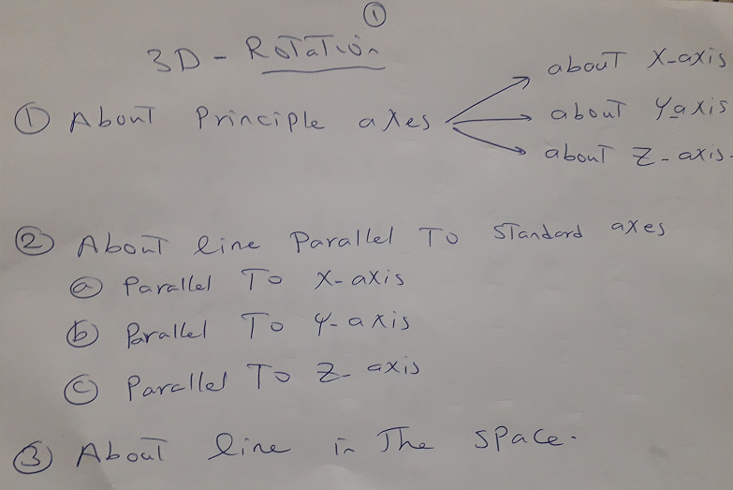
3D ROTATION

Slide 3
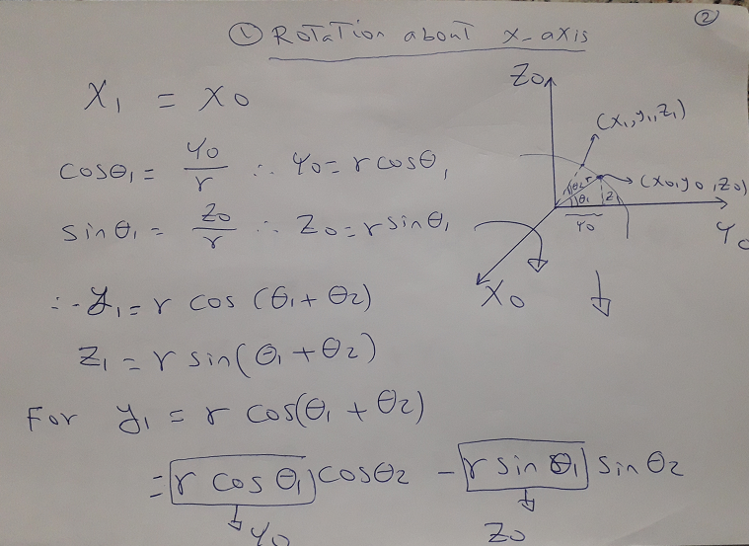
3D ROTATION

Slide 4
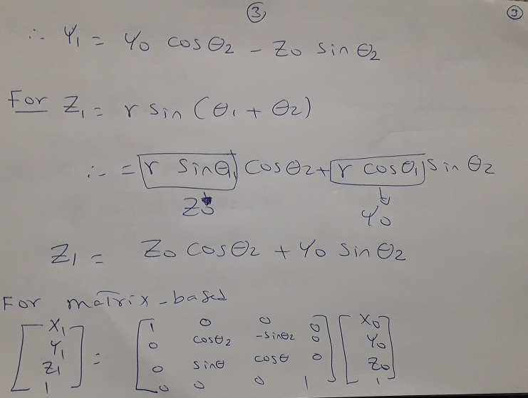
3D ROTATION

Slide 5
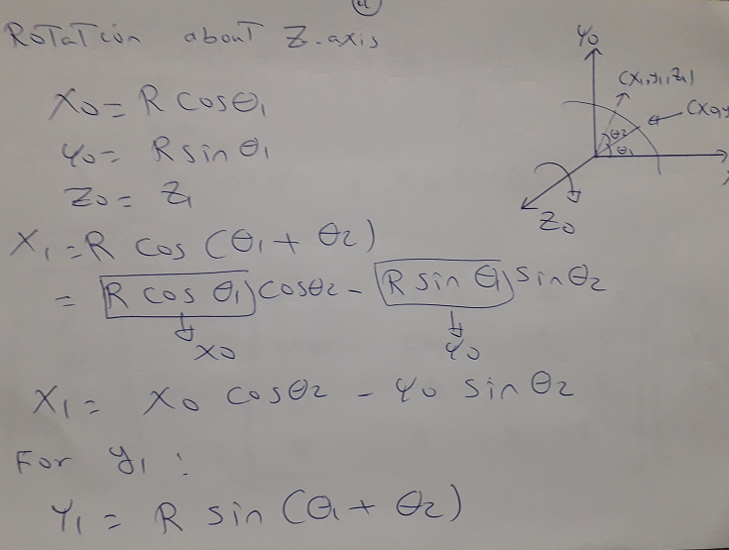
3D ROTATION

Slide 6
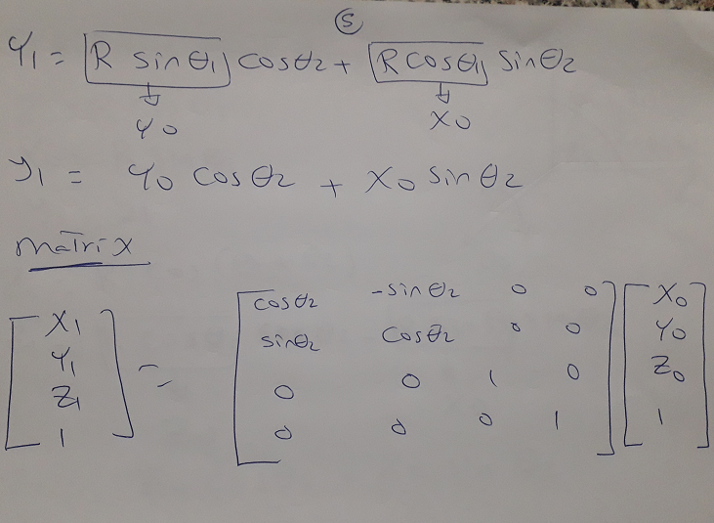
3D ROTATION

Slide 7
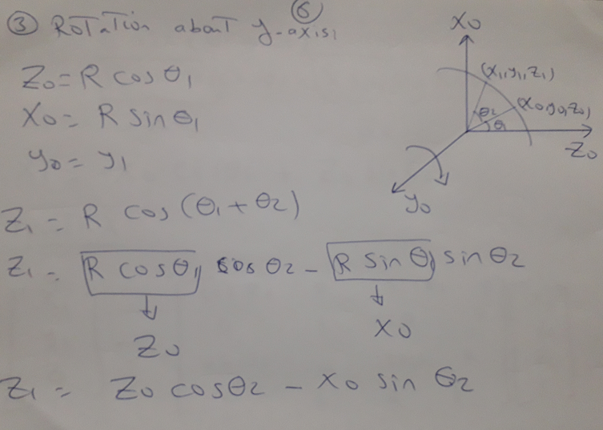
3D ROTATION

Slide 8
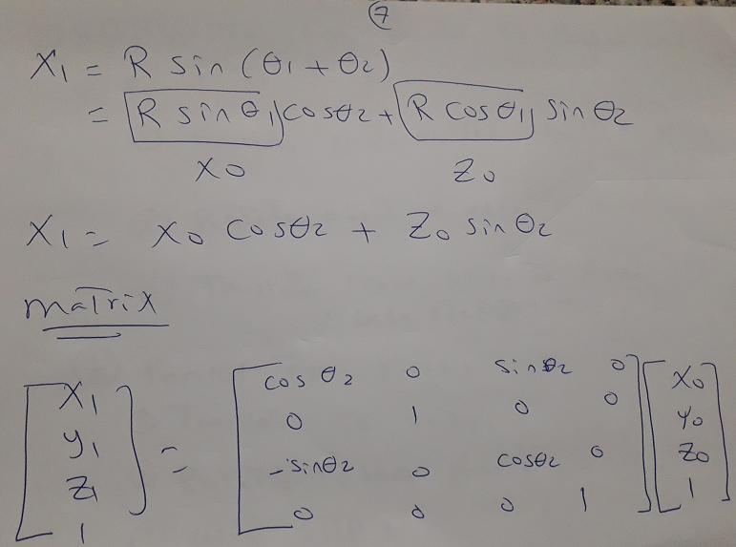
3D ROTATION

Slide 9
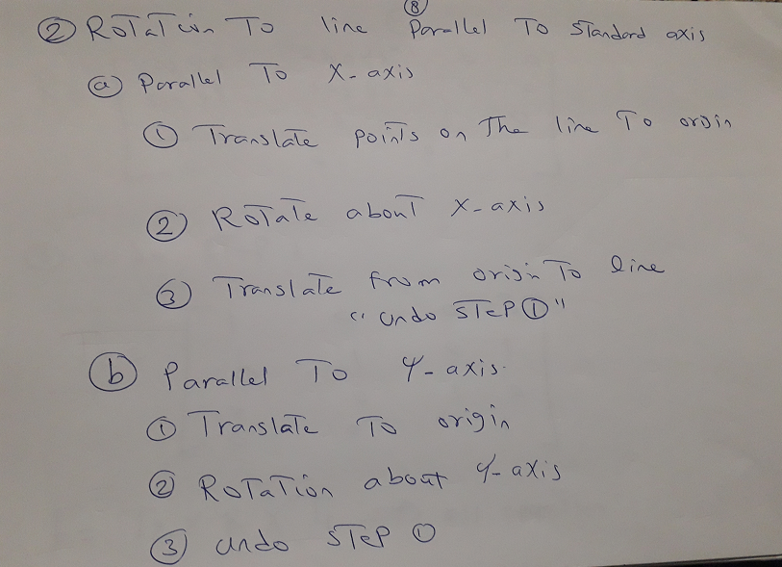
3D ROTATION

Slide 10
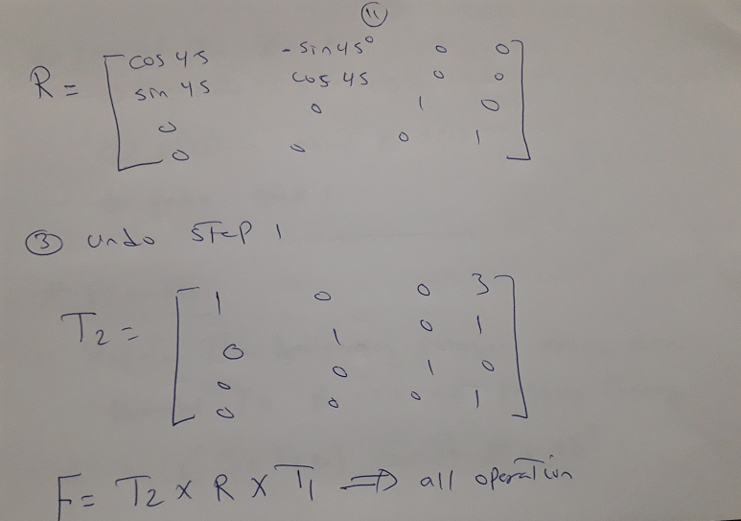
3D ROTATION

Slide 11
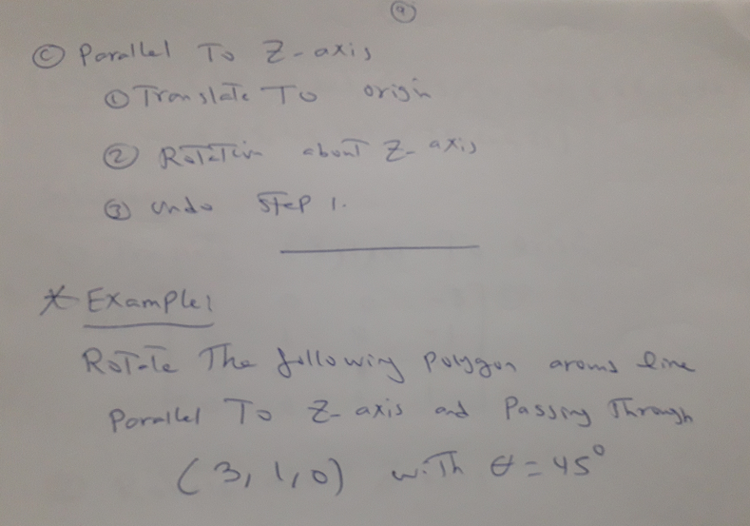
3D ROTATION

Slide 12
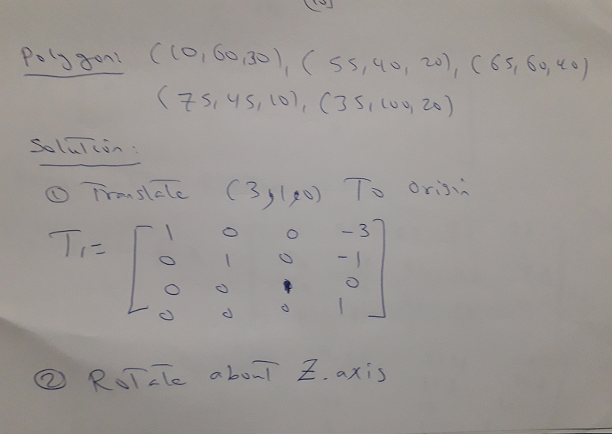
3D ROTATION

Slide 13
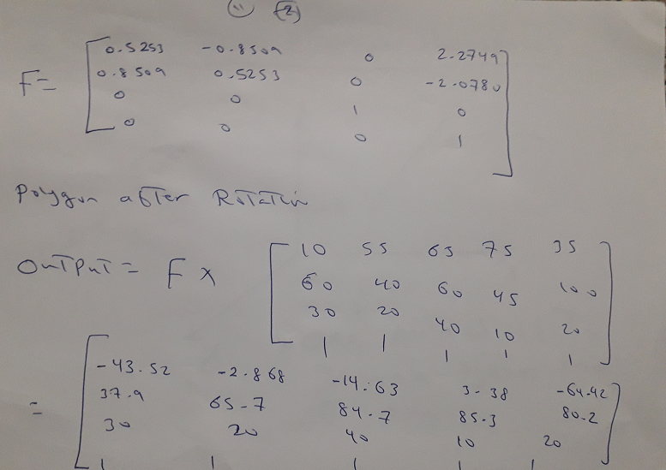
3D ROTATION

Slide 14
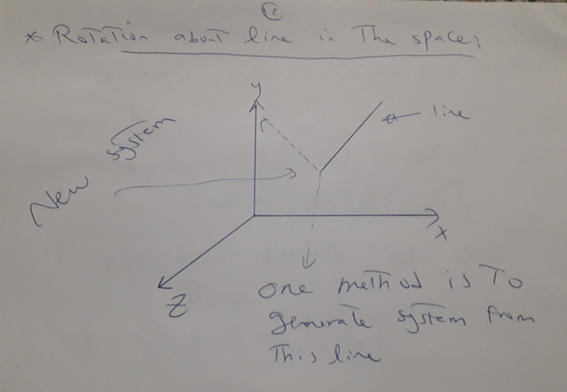
3D ROTATION

Slide 15
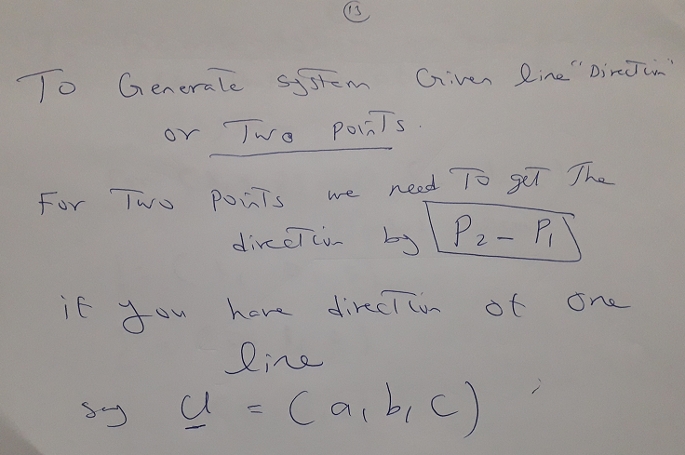
3D ROTATION

Slide 16
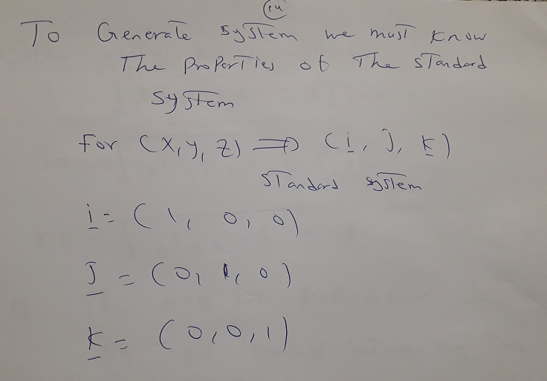
3D ROTATION

Slide 17
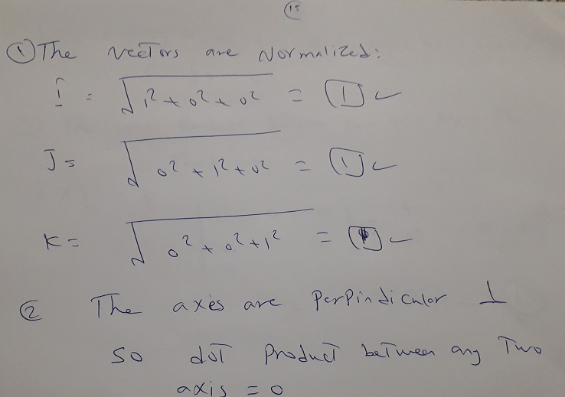
3D ROTATION

Slide 18
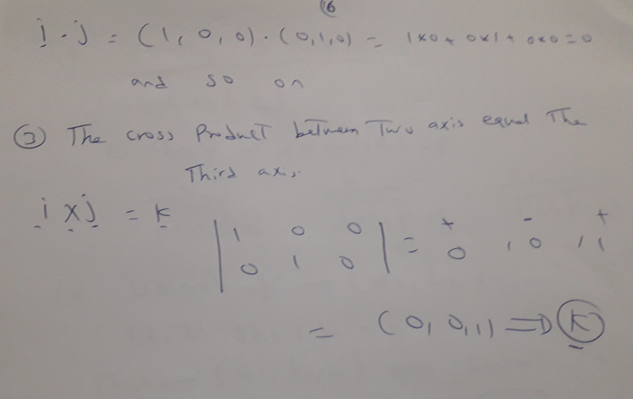
3D ROTATION

Slide 19
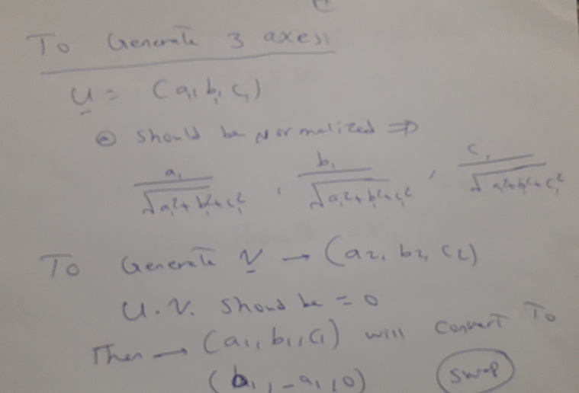
3D ROTATION

Slide 20
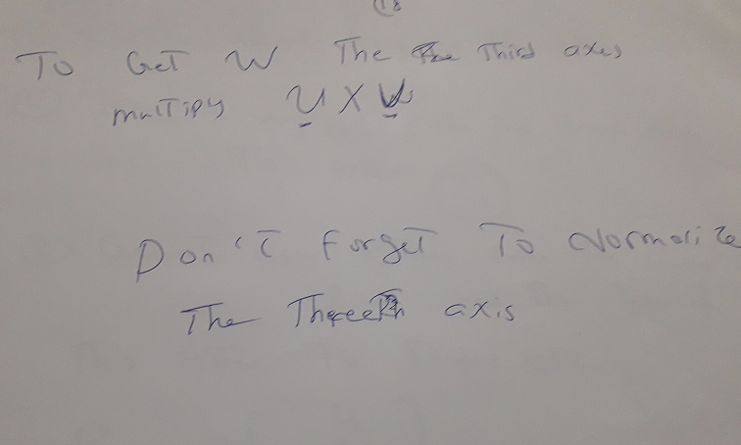
3D ROTATION

Slide 21
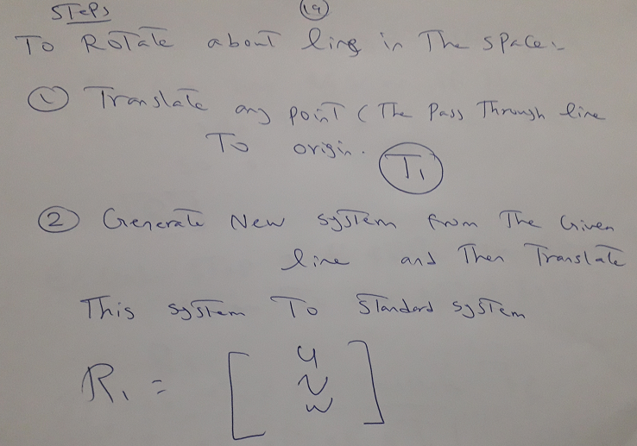
3D ROTATION

Slide 22
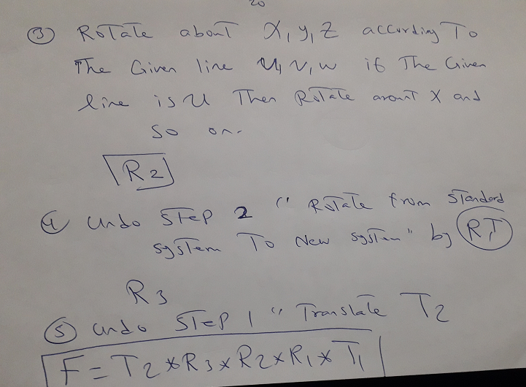
3D ROTATION

Slide 23
3D ROTATION

